Slide 1

Library Management System
The Library Management System is a comprehensive solution for organizing and managing a library's collection, user accounts, and loan activities. It provides a seamless digital experience for both librarians and library patrons.

Slide 2

Objectives
1
Streamline Operations
2
Enhance User Experience
Automate and optimize library processes, reducing manual effort and increasing efficiency.
Provide a user-friendly interface for patrons to easily search, borrow, and manage books.
3
Maintain Inventory
Maintain an up-to-date and accurate record of the library's book collection.

Slide 3
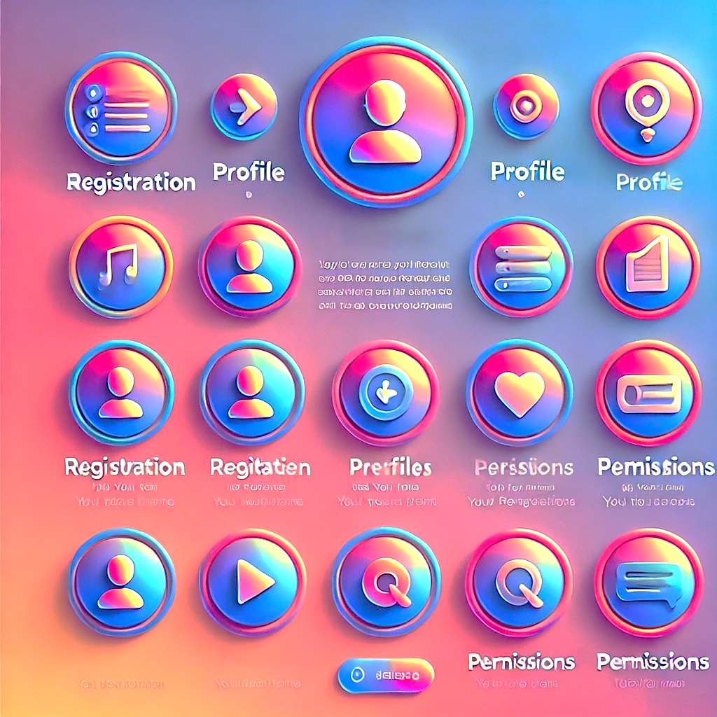
User Management
User Profiles
Registration
Create and manage individual user accounts with unique login credentials.
Allow new users to sign up and provide their personal information.
Permissions
Notifications
Assign different levels of access and privileges to users, such as librarians and patrons.
Send automated notifications to users about due dates, overdue books, and account updates.

Slide 4

Loan Management
1
Checkout
Allow users to borrow books from the library, recording the loan details.
2
Due Dates
Manage the due dates for borrowed books and remind users of upcoming deadlines.
3
Returns
Facilitate the return of borrowed books and update the library's inventory accordingly.

Slide 5

Technical Implementation
1
AVL Tree
2
Class Design
Utilize the AVL tree data structure to efficiently manage the library's book catalog and user accounts.
Implement a modular class hierarchy to encapsulate the various components of the system, such as users, books, and loans.
3
Database Integration
Integrate the system with a robust database to store and retrieve data, ensuring data integrity and scalability.

Slide 6




AVL Tree Data Structure
Self-Balancing
The AVL tree automatically maintains balance, ensuring efficient search, insertion, and deletion operations.
Performance
The AVL tree's logarithmic time complexity for key operations makes it well-suited for large-scale library catalogs.
Scalability
The AVL tree's structure allows for easy expansion and management of the growing library collection.

Slide 7
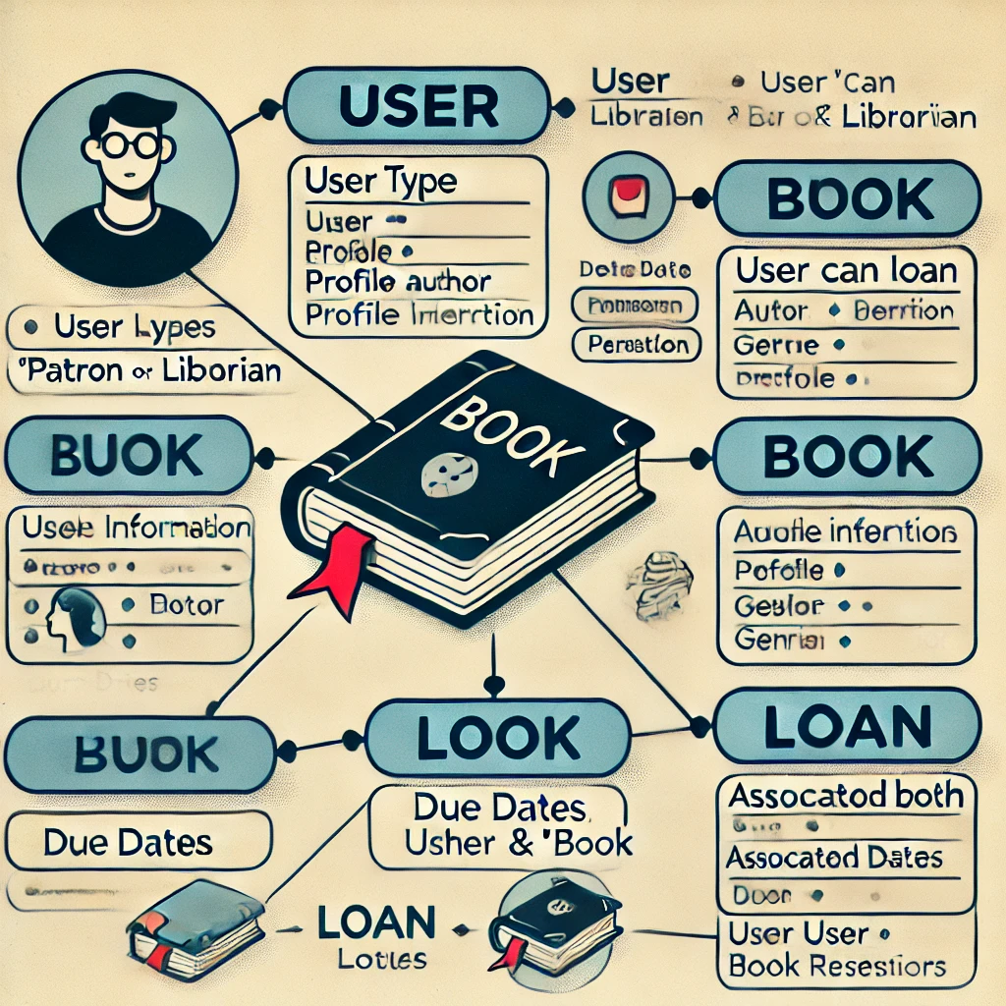



Class Design
User
Represents individual users, including patrons and librarians, with unique profiles and permissions.
Book
Encapsulates the attributes and behaviors of each book in the library's collection.
Loan
Manages the details of book loans, including due dates and return status.

Slide 8

Conclusion
The Library Management System provides a robust and versatile solution for libraries of all sizes. By leveraging advanced data structures and modular class design, the system ensures efficient operations, enhanced user experiences, and seamless management of the library's collection.
Future enhancements may include integrating with e-book platforms, implementing machine learning for personalized recommendations, and developing a mobile app for on-the-go access.

